Slide 1
CLOUD SOLID: Building Highly Maintainable Applications in a Cloud-Enabled World
Casey Watson
Senior Software Engineer | CSE
cawatson@microsoft.com | @_caseywatson

Slide 2
This is Robert “Uncle Bob” Martin.
In 2003, he published his seminal article describing five universal principles for building highly cohesive, loosely coupled applications.

Slide 3
SOLID Principles
S
O
L
I
D
ingle Responsibility Principle (SRP)
pen/Closed Principle (OCP)
iskov Substitution Principle (LSP)
nterface Segregation Principle (ISP)
ependency Inversion Principle (DIP)

Slide 4
The following presentation is based on real projects.

Slide 5
Contoso Outdoor Living
Seattle-based outdoor supplies retailer
Opened first brick and mortar location in the early 90s
Sells everything from patio furniture to camping supplies
Loyal customer base
Experiencing rapid growth with seasonal fluctuations in business
Basic online presence with limited e-commerce functionality
Just completed acquisition of Adventure Works Cycles
Concerned about impact of “big box” online retailers

Slide 6
Meet Mike and Sharon
Mike is the Vice President of IT at Contoso
Created Contoso’s original web site
Responsible for merging Contoso and Adventure Works IT organizations
Knows just enough about application development to be dangerous
Has recently been learning about the cloud
Sharon is the Lead Application Architect at Contoso
Started at Contoso three months ago
Deep background in .NET and web development
Has recently been learning about the Microsoft Azure platform

Slide 7
The board wants to completely refresh our online presence to better compete with the “big box” online retailers. We’re talking user ratings and reviews, order tracking… the works.
I promised them that we would launch in six months.
I realize that this is a tall order so I want you to pull in the Adventure Works developers.
They’re MEAN stack (Mongo DB, Express, AngularJS and Node.js) developers.

Slide 8
Initial Design
Notes:
Take what we know from on-premises and lift and shift to the cloud.

Slide 9
Initial Design Review
It’s simple.
It’s relatively scalable.
As we scale, it could become very costly.
It’s going to be very difficult to work across languages and platforms.
Virtual machines will still need to be managed by someone.
Notes:
Only one deployable application to manage
Coarsely-grained scalability

Slide 10
Single Responsibility Principle
A class should have only one reason to change.
Notes:
Martin defines a responsibility as a reason to change, and concludes that a class or module should have one, and only one, reason to be changed (i.e. rewritten).
While the application code itself may adhere to SRP, as a service, our application has many reasons to change.

Slide 11
Current Design
Notes:
Review current design.
Mention responsibility in the context of IT’s responsibility to maintain the VMs that make up the application. While the VMs reside in the cloud, IT is still responsible for configuring, patching and managing the VMs.
Mention that Azure does provide a SLA for VMs of 99.95% but that does not cover the software that’s running on the VMs.
Difficult to work independently on the application as it continues to grow.
If any single component of your application fails, the entire application is unavailable.

Slide 12
Platform as a Service (PaaS)
Notes:
Take a step in the right direction by moving from VMs to PaaS.
While PaaS gives us less control, it also relieves IT’s management burden and gives us a better SLA.
Business logic has been moved from the ASP.NET MVC front-end to the Node.js API back-end.
We can now leverage our Node.js developers to build out our back-end API since both ASP.NET (C#) and Node.js speak REST “as a second language.”
While the architecture is improving, we still don’t have SRP at a service level. The API is responsible for many functions.

Slide 13
Containers + Microservices
Notes:
Further embracing SRP.
Services can be scaled rapidly and independently of each other.
Finer-grained scalability.
Greater service density drives down costs even further.
Docker provides increased developer productivity.
Gets rid of “it works on my machine.”

Slide 14
Serverless*
Notes:
Brings SRP to the next level.
Much more granular and simpler code makes it much easier to maintain and understand.
Implicitly scalable.
Relying on the underlying cloud platform to provide more of the “glue”.
Least control with most automation.
Definitely the cheapest option.

Slide 15
Containers + Functions

Slide 16
Single Responsibility Principle
A class should have only one reason to change.
A service should have only one reason to change.

Slide 17
Current Architecture

Slide 18
After a customer places an order, they should receive a confirmation e-mail.
We also need to add integration with Azure SQL Warehouse. The data warehouse should be updated after a new order is placed.
I’ll start working on these features.
They should be pretty easy.

Slide 19
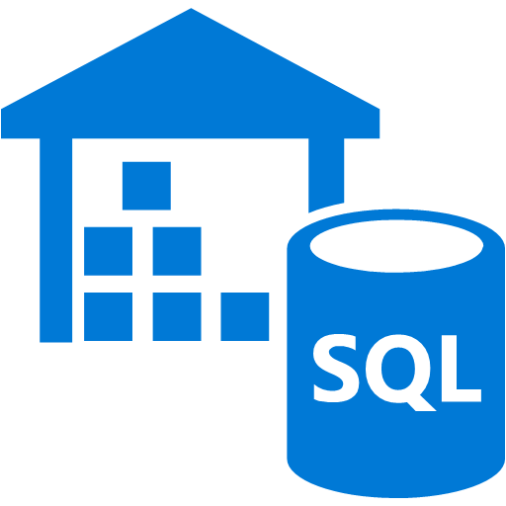



Extending the Place Order function
Azure Kubernetes Service
Update Data Warehouse
SQL Data Warehouse
Software entities should be open for extension, but closed for modification.
Place Order
Send Order Confirmation Email
Web App
Email
Azure SQL Database

Slide 20
What?! The build’s broken! A unit test is failing.
It looks like I broke something when I made that last change to the Place Order service.
No problem. It’s an easy fix. Once I’m done, I’ll commit my changes and submit a new pull request.
I’m glad you caught the bug quickly but this has been happening a lot lately across the project.
We need to make it easier to add new features without having to modify existing code.

Slide 21
Open/Closed Principle
Software entities should be open for extension, but closed for modification.

Slide 22


Making the Place Order function more extensible
Update Data Warehouse
SQL Data Warehouse
Place Order
Send Order Confirmation Email
Email
Order Placed Event
Service Bus Topic
Update Inventory
Azure SQL Database

Slide 23
Sending the Comment Added email
Place Order
Send Order Confirmation Email
Email
Order Placed Event
Service Bus Topic
Add Comment
Send Comment Added Email
Email
Comment Added Event
Service Bus Topic

Slide 24
Refactoring the email pipeline
Compose Order Confirmation Email
Send Email Command
Compose Comment Added Email
Send Email
Email
Send Email Command
Service Bus Topic
Compose Promotional Email
Send Email Command
Email Sent Event

Slide 25
This makes things so much simpler.
We’re feeling better about hitting that deadline.
Sharing a common data model is causing some friction, though. Schema changes we made for Shopping Carts recently broke Ordering.
Complex joins are also causing some database performance issues.

Slide 26




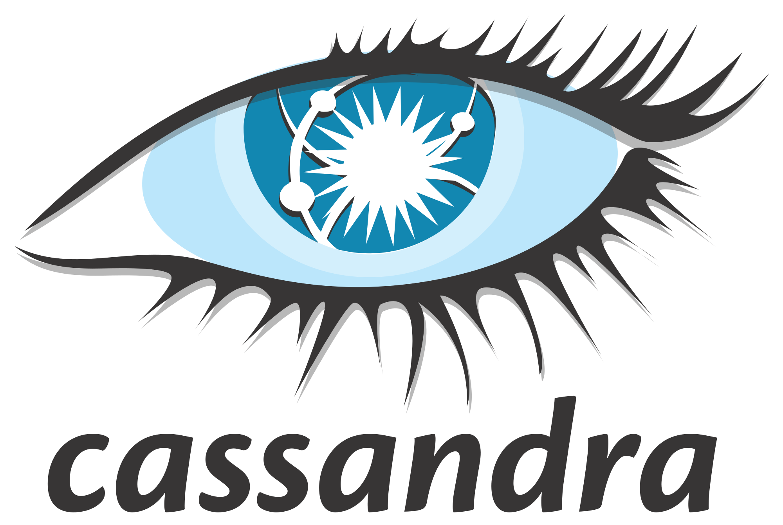
Closing Data Models
Ordering
Item Catalog
Shopping Cart
Place Order
Search Items
Add Item
Azure Search
Cancel Order
Get Item Detail
Remove Item
Cosmos DB
Get Order History
Get Item Photos
Get Cart
Blob Storage
Azure SQL Database
Events
Cosmos DB

Slide 27
Open/Closed Principle
Software entities should be open for extension, but closed for modification.
Services should be open for extension, but closed for modification.

Slide 28
The new site is looking great!
I am, however, concerned about disaster recovery. What happens if there’s a problem with Azure?
Let’s set up a failover site in our own data center just in case.
Sigh…
Let me see what I can do.

Slide 29
Liskov Substitution Principle
Objects in a program should be replaceable with instances of their subtypes without altering the correctness of that program.

Slide 30
Azure User Review Architecture
Azure Kubernetes Service
User Reviews
Get Reviews
Add Review
Cosmos DB
Web App
Add Comment
Review Events
Service Bus Topic

Slide 31

On-Premises User Review Architecture
Kubernetes Cluster
User Reviews
Get Reviews
Web UI
Add Review
Add Comment
Cassandra DB
Review Events
Kakfa Topic

Slide 32
Azure + On-Premises Consistency
Azure
On-Premises
Web App
Service Bus Topic
Kafka Topic
Add Review
Publish Review
Import Review API
Import Review
Get Reviews
Publish Review
Cassandra DB
Get Reviews
Cosmos DB
Import Review
Import Review API
Publish Review
Add Review
Web UI
Service Bus Topic
Kafka Topic

Slide 33




Portability + Global HA/DR
Azure Traffic Manager
contosooutdoors.trafficmanager.net
Events

Slide 34
Liskov Substitution Principle
Objects in a program should be replaceable with instances of their subtypes without altering the correctness of that program.
Services in an application should be replaceable without altering the correctness of that application.

Slide 35
Inventory is managed by a custom, in-house ERP system that handles all warehouse functions. We’ll need to access it to build out the Inventory service.
Liskov Substitution Principle
I’ll go talk to Paul, the lead ERP architect, to see what’s involved. Hopefully it’s not too complicated.
Objects in a program should be replaceable with instances of their subtypes without altering the correctness of that program.
Accessing the ERP system is actually pretty easy.
We expose all of the ERP functionality through a single SOAP-based web service.
All you need to do is plug in to that.
Services in an application should be replaceable without altering the correctness of that application.

Slide 36
Interface Segregation Principle
Many client-specific interfaces are better than one general-purpose interface.

Slide 37



Integrating with the ERP System
On-Premises
Azure
SOAP Web Service
Check Inventory
Shipping
Inventory
Purchasing
ERP
Scheduling
Inventory API
Cache
Notes:
ERP handles shipping, inventory, purchasing and scheduling.
ERP system is what we call a “legacy” application but it works well.
ERP web service started small, but over the years more and more methods have been added to it. This is typical especially under demanding deadlines.
ERP web service does not adhere to Single Responsibility Principle or Interface Segregation Principle but it does adhere to the Open/Closed Principle.
The Inventory API creates an “anti-corruption layer” that insulates our application from the ERP system.
The Inventory API adheres to the Interface Segregation Principle by providing a client-specific interface to the ERP web service. If, in the future, we needed access to Shipping, we would create a Shipping API.

Slide 38
Interface Segregation Principle
Many client-specific interfaces are better than one general-purpose interface.
Many client-specific services are better than one general-purpose service.

Slide 39
The application is coming along great. We’re still on target to hit our launch date in a few weeks.
Adding on-premises into the mix has definitely made things more complicated. We’re now working in two separate branches which is causing some friction.
There’s got to be an easier way to do this.

Slide 40
Dependency Inversion Principle
One should depend upon abstractions, not concretions.

Slide 41
Reviewing the email pipeline
Azure Kubernetes Service
Pod
Compose Order Confirmation Email
Send Email Command
Service Bus Topic

Slide 42
Sidecar containers
Azure Kubernetes Service
Pod
http://localhost:8080
Compose Order Confirmation Email
Sidecar A
Send Email Command
Service Bus Topic
http://localhost:8081
http://localhost:8082
Sidecar B

Slide 43
Publishing through ambassadors
Azure Kubernetes Service
Pod
Compose Order Confirmation Email
Service Bus Topic Publisher
http://localhost:8080
Send Email Command
Service Bus Topic
Kafka Topic Publisher
Send Email Command
Kafka Topic

Slide 44
Subscribing through ambassadors
Azure Kubernetes Service
Pod
http://localhost:8081
http://localhost:8080
Service Bus Topic Subscriber
Compose Order Confirmation Email
Service Bus Topic Publisher
Order Placed Event
Service Bus Topic
Kafka Topic Subscriber
Order Placed Event
Kafka Topic

Slide 45


Other ambassador scenarios
Azure Kubernetes Service
Pod
Azure Blob Storage Provider
Application Service
Application Insights Logger
Azure Blob Storage
Application Insights
http://localhost:8080
http://localhost:8081
Local Blob Storage Provider
Kafka Topic Logger
Local File System
Kafka Topic

Slide 46
Dependency Inversion Principle
One should depend upon abstractions, not concretions.

Slide 47
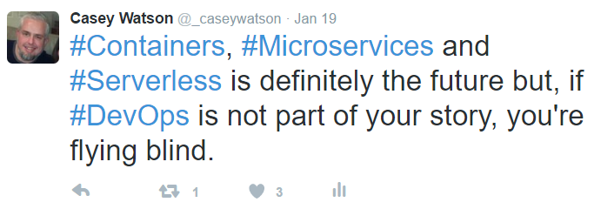
The Importance of DevOps
Increased deployment complexity
Health monitoring is critical
Leverage versioning when rolling out updates
Define your branching strategy up front
Automation is key
Notes:
With more smaller, granular components, deployments can quickly become more complex.
It’s important to be able to see the forest for the trees. With traditional applications, the application is either up or down. In this application, we have potentially hundreds of small components that need to be monitored.
You will invariably create new versions of services and update the APIs that they support.

Slide 48
SOLID Principles Review
S
O
L
I
D
ingle Responsibility Principle (SRP)
pen/Closed Principle (OCP)
iskov Substitution Principle (LSP)
nterface Segregation Principle (ISP)
ependency Inversion Principle (DIP)

Slide 49
The SOLID principles are not rules. They are not laws. They are not perfect truths. They are statements on the order of “An apple a day keeps the doctor away.” This is a good principle, it is good advice, but it’s not a pure truth, nor is it a rule.
Robert “Uncle Bob” Martin
Getting a SOLID Start, 2009

Slide 50
aka.ms/cloudsolid
CLOUD SOLID Article Series on the AzureCAT Guidance Blog

